Slide 1

Huazhong University of Science and Technology
The Department of Electronics and Information Engineering
Electronic Circuit Analysis and Design
Electronic Circuit Analysis and Design
Dr. Tianping Deng
Email: dengtp@hust.edu.cn

Slide 2
Contents
PART 1 SEMICONDUCTOR DEVICES AND BASIC APPLICATIONS
Chapter 1 Semiconductor Materials and Diodes
Chapter 2 Diode Circuits
Chapter 3 The Field-Effect Transistor
Chapter 4 Basic FET Amplifiers
Chapter 5 The Bipolar Junction Transistor
Chapter 6 Basic BJT Amplifiers
Chapter 7 Frequency Response
Chapter 8 Output Stages and Power Amplifiers
PART 2 ANALOG ELECTRONICS
Chapter 9 Ideal Operational Amplifiers and Op-Amp Circuits
Chapter 10 Integrated Circuit Biasing and Active Loads
Chapter 11 Differential and Multistage Amplifiers
Chapter 12 Feedback and Stability
Chapter 13 Operational Amplifier Circuits
Chapter 14 Nonideal Effects in Operational Amplifier Circuits
Chapter 15 Applications and Design of Integrated Circuits
Chapter 4 Basic FET Amplifiers

Slide 3
Ch4 Basic FET Amplifiers
4.1 The MOSFET Amplifier
4.2 Basic Transistor Amplifier Configurations
4.3 The Common Source Amplifier
4.4 The Common Drain（Source Follower） Amplifier
4.5 The Common Gate Configuration
4.5.1 Small voltage and current gains
4.5.2 Input and output Impedance
4.6 The Three Basic Amplifier Configuration:
Summary and comparison

Slide 4
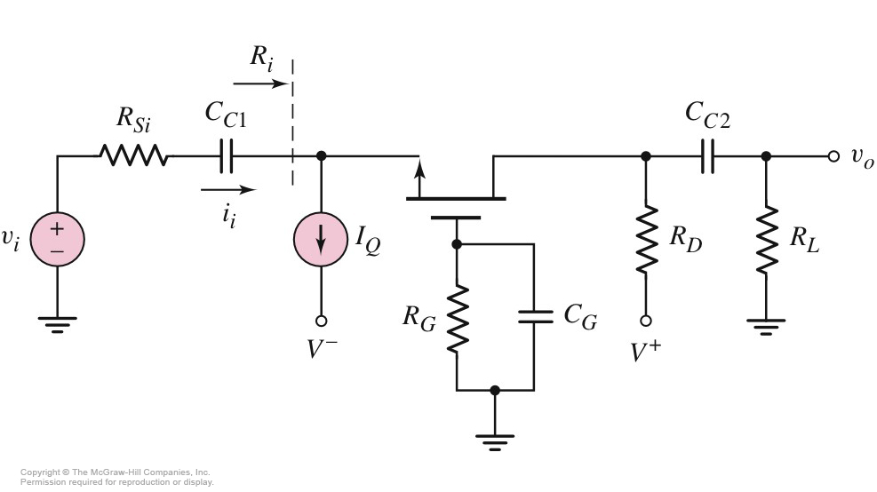
4.5 The Common Gate Configuration
CG

Slide 5
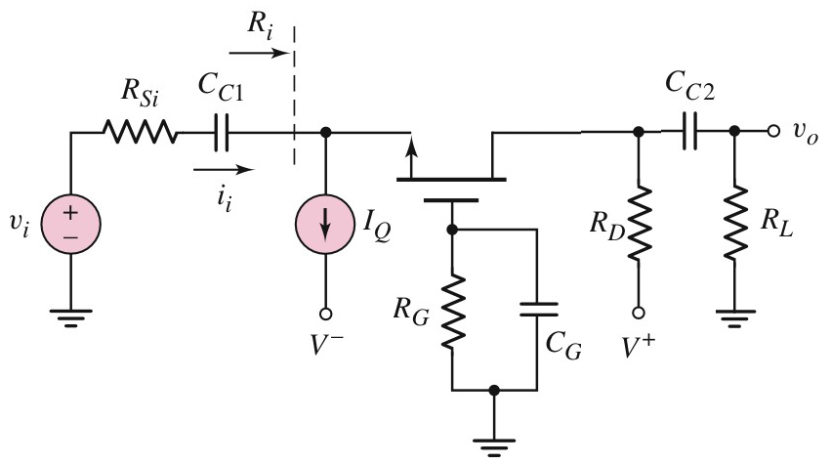
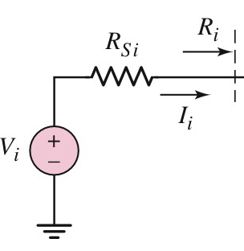
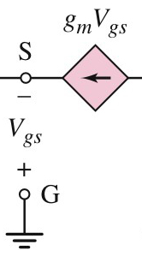
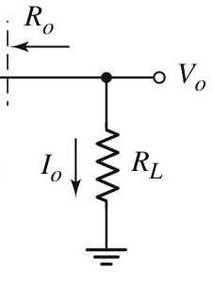

4.5.1 Small voltage and current gains
Small-Signal Equivalent Circuit

Slide 6
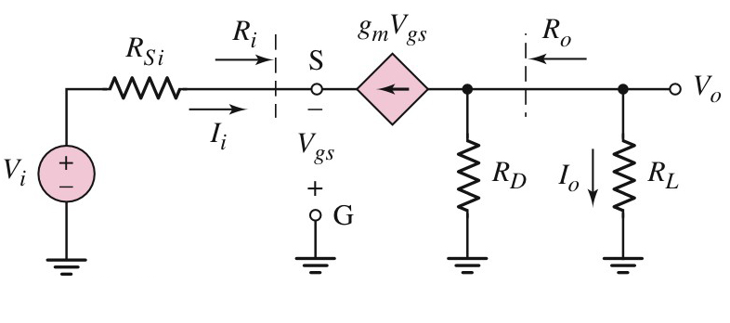
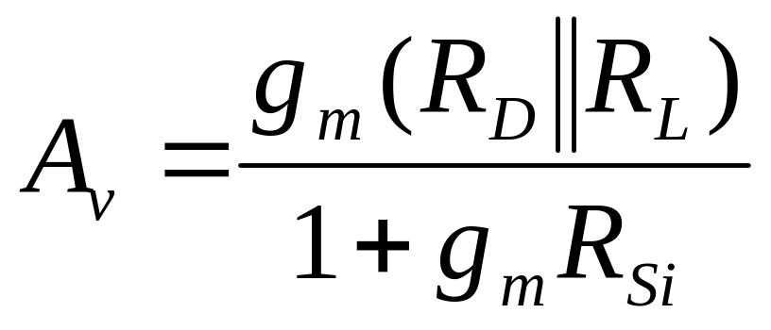
4.5.1 Small voltage and current gains
V_{o} =－g_{m} •V_{gs} •(R_{D}//R_{L})
V_{i} =I_{i} • R_{Si}－V_{gs}
I_{i} =－g_{m} • V_{gs}

Slide 7
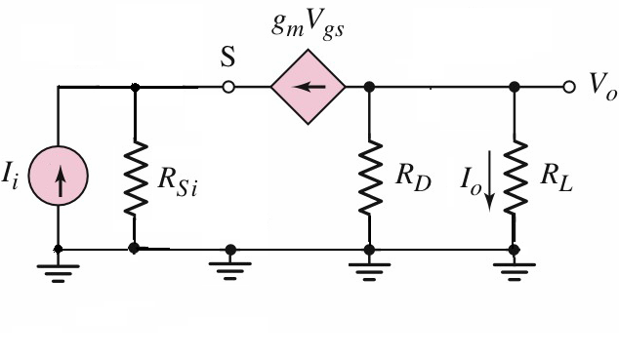
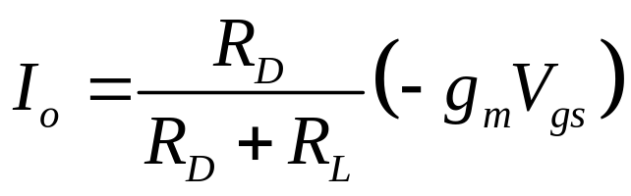
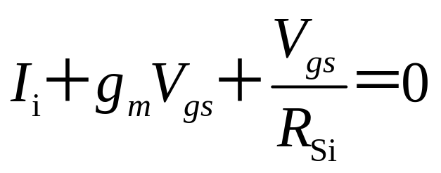
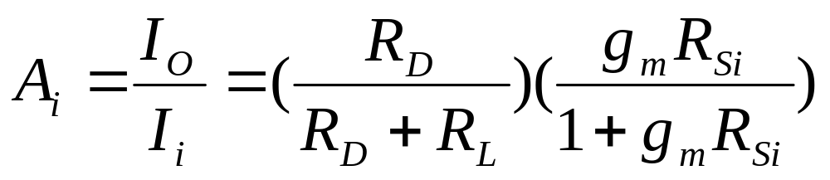
4.5.1 Small voltage and current gains
Norton equivalent circuit

Slide 8
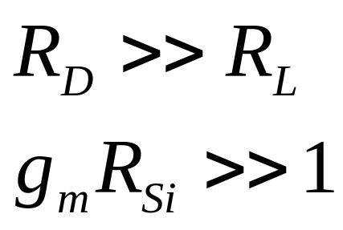
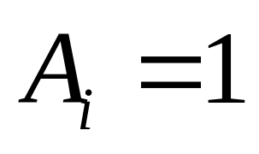
4.5.1 Small voltage and current gains
Current follower

Slide 9
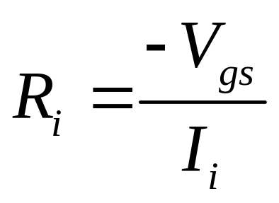
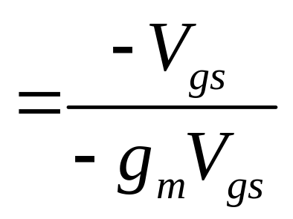
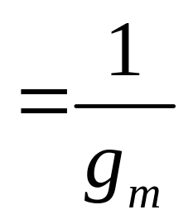
4.5.2 Input and output Impedance
Input Impedance is very low

Slide 10
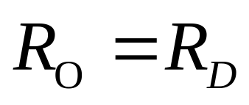
4.5.2 Input and output Impedance

Slide 11
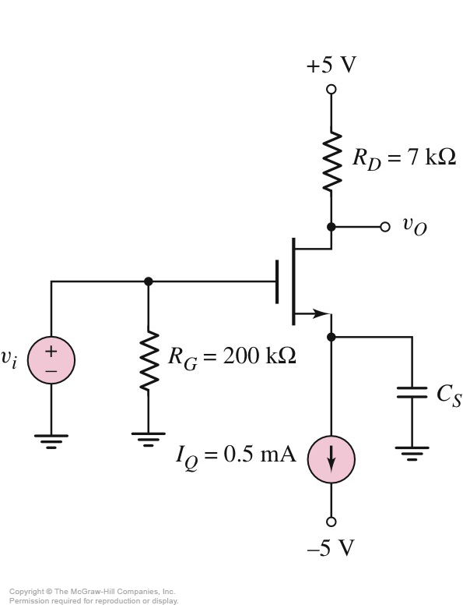
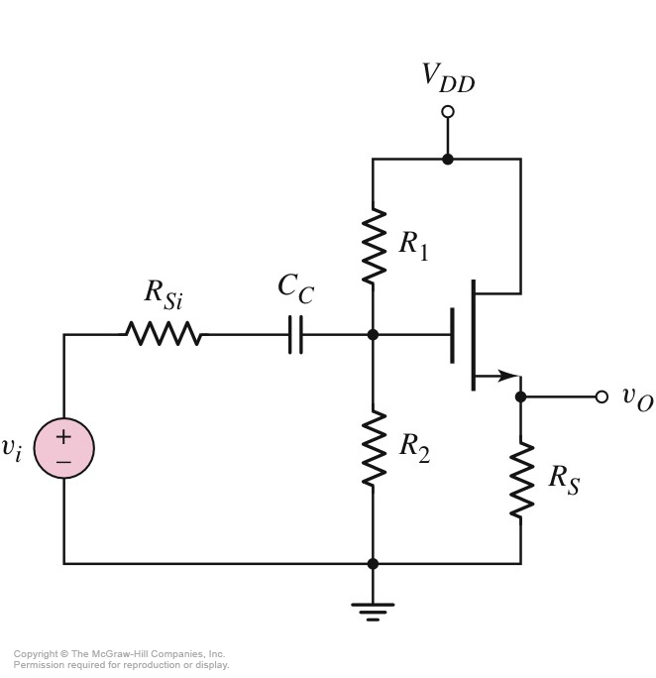
4.6 The Three Basic Amplifier Configuration:Summary and comparison
CS
CD
CG

Slide 12
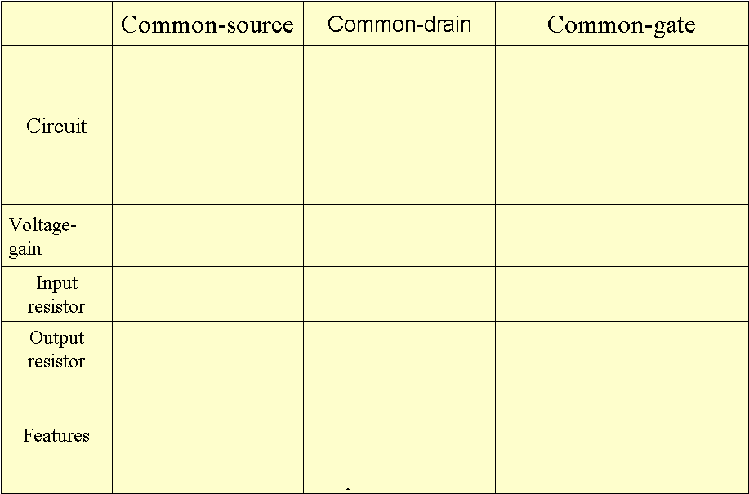
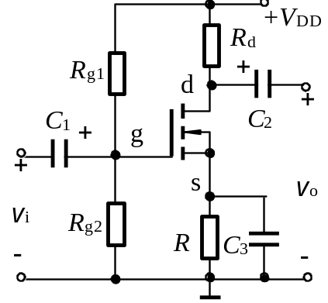
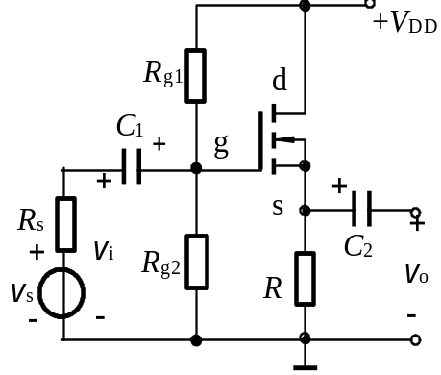
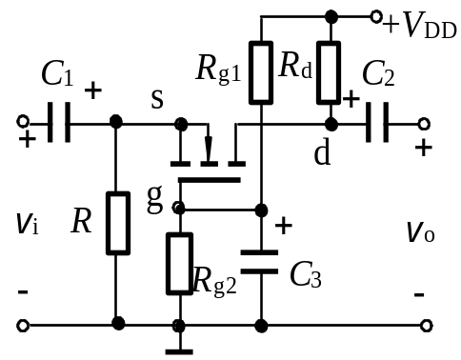

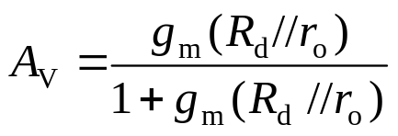
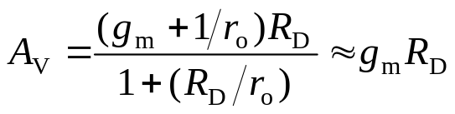
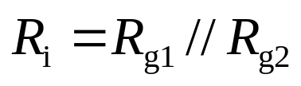
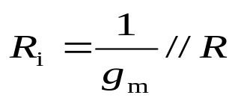
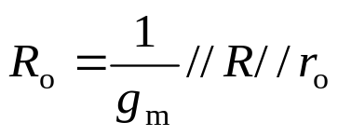
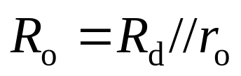

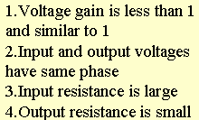

Comparing three basic circuit of field effect transistor

Slide 13
Comparing three basic circuit of field effect transistor
Configuration | Voltage Gain | Current Gain | Input Resistance | Output Resistance
Common Source | A_{v} > 1 | __ | R_{TH} | Moderate to high
Source Follower | A_{v} ≈ 1 | __ | R_{TH} | Low
Common Gate | A_{v} > 1 | A_{i} ≈ 1 | Low | Moderate to high

Slide 14
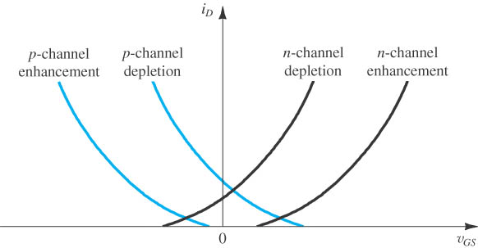
Overview
The i_{D}–v_{GS} Characteristic in Saturation

Slide 15
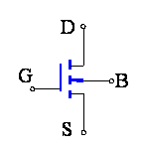
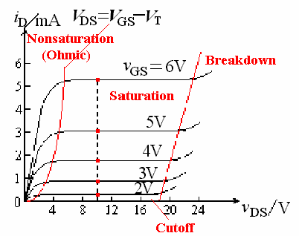
Overview
For chapter 3 and chapter 4:
1、MOSFET structure，feature, i-v characteristic

Slide 16
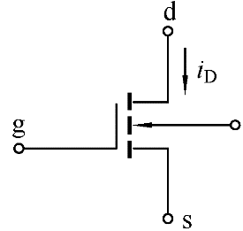
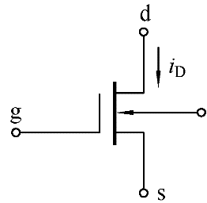
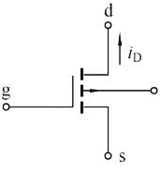
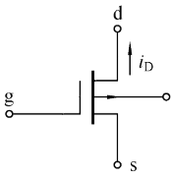
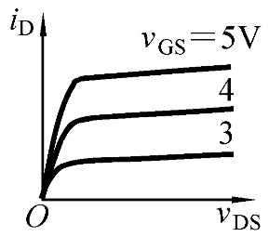
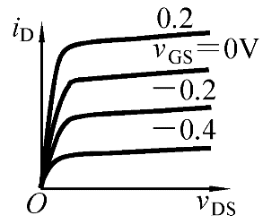
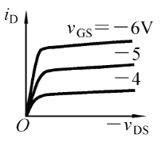
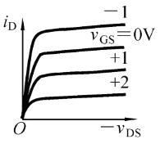
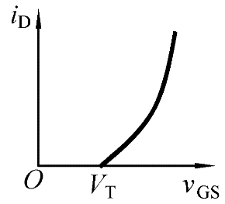
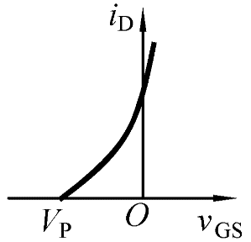
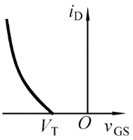
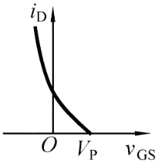
 | NMOS E-Mode | NMOS D-Mode | PMOS E-Mode | NMOS D-Mode
Circuit Symbol
Output Characteristic
Transfer Characteristic
V_{GS} (Saturation Reg.)
V_{DS} (Saturation Reg.)
V_{GS} >V_{TN} >0
V_{GS} >V_{P}
V_{GS} <V_{TP} <0
V_{GS} <V_{P}
V_{DS} >V_{GS}-V_{TN} >0
V_{DS} >0
V_{DS} <V_{GS}-V_{TP} <0
V_{DS} <0

Slide 17
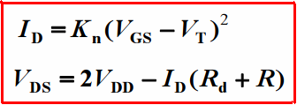
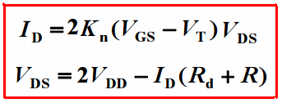
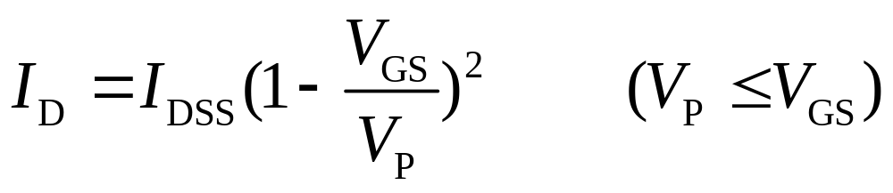
Overview
2、DC analysis
Calculate V_{GS} 、 I_{D} 、 V_{DS}
A、For enhancement NMOS
Saturation region
Non-saturation region
B、For depletion NMOS

Slide 18
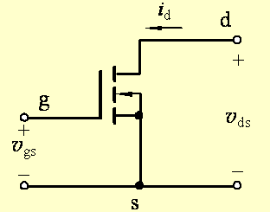
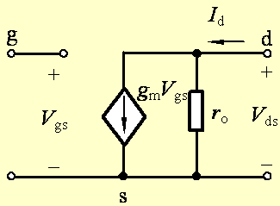


Overview
3、AC analysis

Slide 19

(1) The Reason of Using Multistage Circuit
A single transistor amplifier will not be able to meet the combined specifications of a given amplification factor, input resistance, and output resistance.
(2) Cascade Configuration
3 circuits are connected in series, or cascaded. Each circuit can be CE, CC, or CB configuration

Slide 20
(3) Loading effect
E.g. R_{i2} is the load of stage 1.
R_{i2} = R_{L1}
R_{o1} = R_{S2}

Slide 21

CD
CS
CS-CD

Slide 22


Determine Q-point，A_{v}

Slide 23







SOL：1.Q-point
DC Circuit
In sat.

Slide 24







For T₂

Slide 25

2. A_{v}
Small signal Eq.

Slide 26




If not sketch this small signal circuit, how to get this？

Slide 28



Slide 29
Questions
and
Answers

